Slide 1
DOMINION GREENHOUSES
Presented by Team Trogdor
https://github.com/netengtechsolutions/bulknetwork
Notes:
Hello my name is Jacob bush welcome to our Capstone project.
introduce Yasin Gomus.
introduced Darren Sylvane.

Slide 2
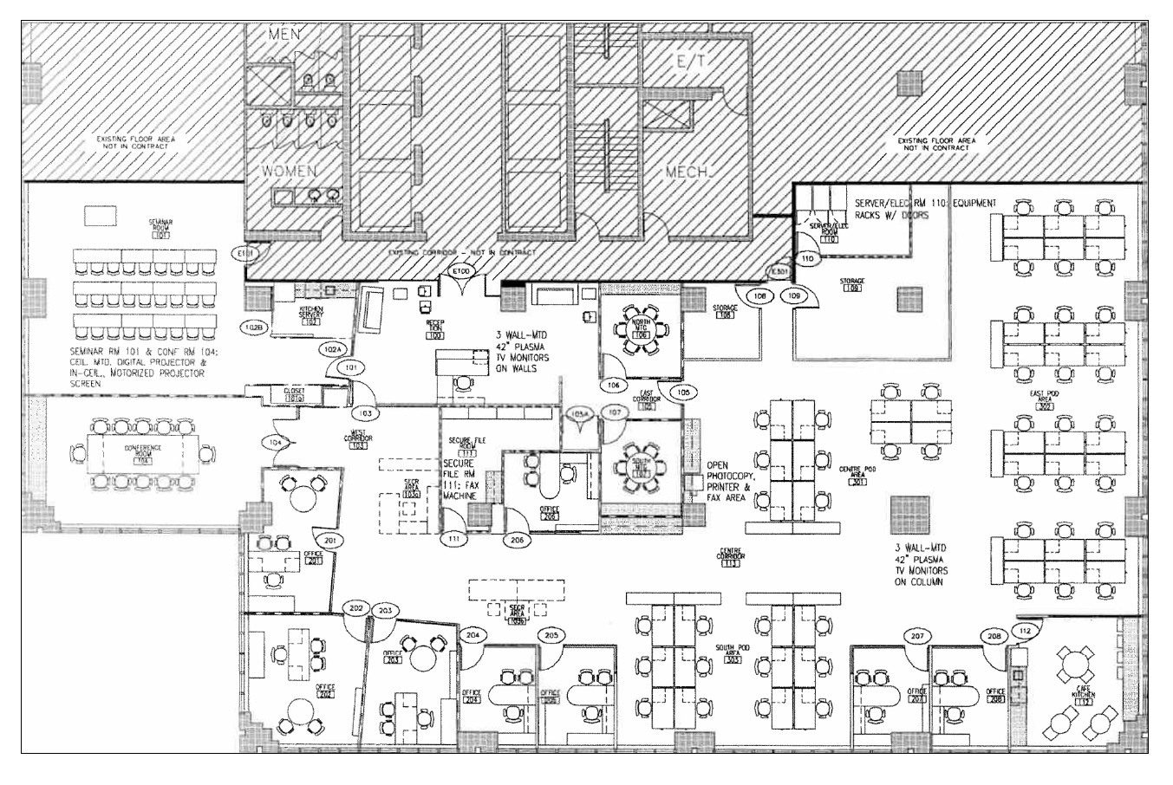
Overview Slide – HQ Floor Plan
Notes:
Staring off we need a little context for our scenario. Our Capstone is based off of our final project from last semesters Project Management Course.
Our customer, DominionGreenHouses currently resides in their headquarters with about 75 employees. The Image you see now is the floor plan of their HQ.
They have a windows 2003 domain with Windows 7 workstations.
DominionGreenHouses has also recently acquired a new manufacturing facility and warehouse to expand their business.
Our job is to upgrade their existing server infrastructure to modern standards. As well as integrate their new physical infrastructure.

Slide 3
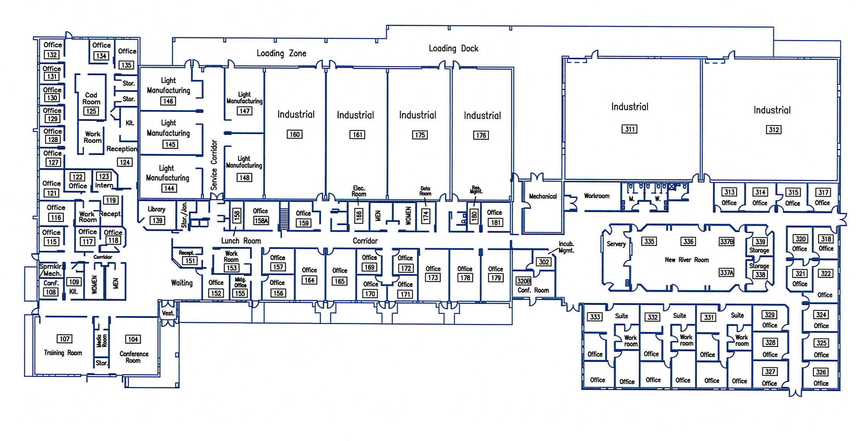
Plant Floor Plan
Notes:
The image you see now is the floor plan for the manufacturing plant which will house 150 employees.
The manufacturing plant has some special requirements not found in the other buildings.
Thin clients will be required in both a clean room and a heavy industrial room. Adequate wireless coverage is required on the floor of the manufacturing areas including docking areas.

Slide 4
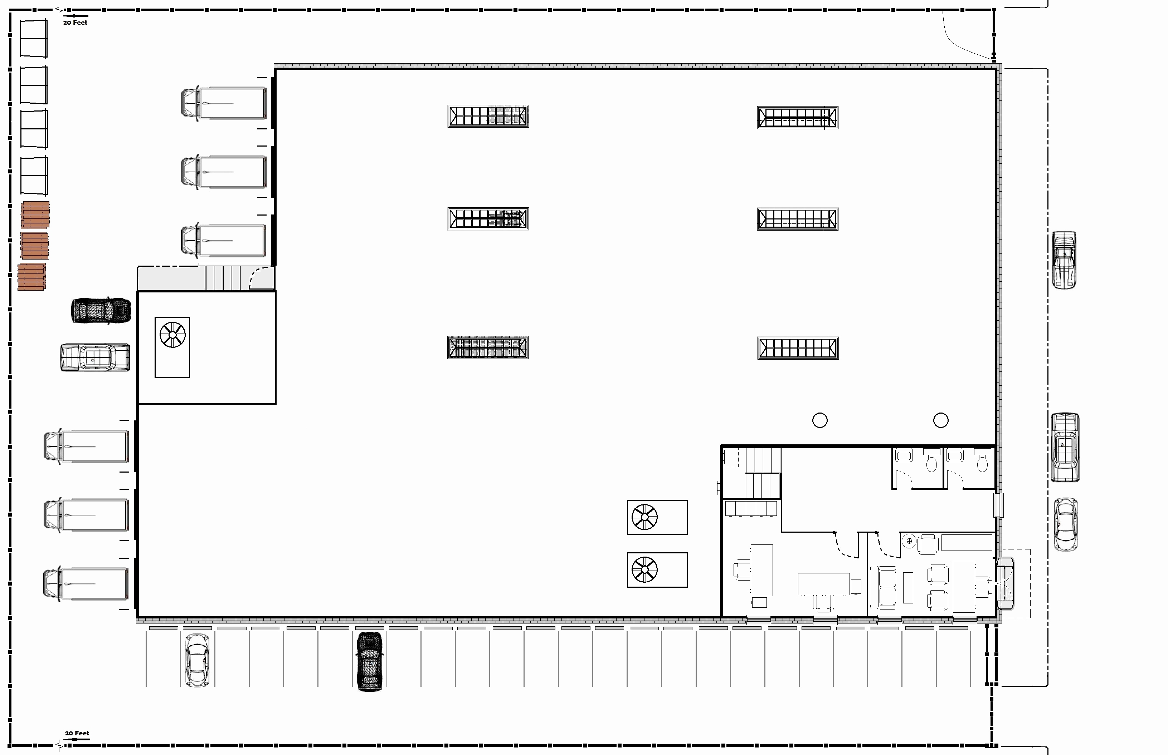
Warehouse Floor Plan
Notes:
The image you see now is the floor plan for the warehouse which will house 4 employees.
Wireless coverage is required throughout the warehouse.
So without further ado. Yasin will start our presentation with our on-prem virtualization.

Slide 5
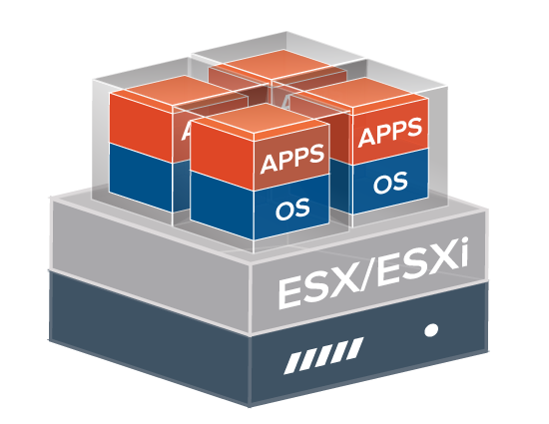
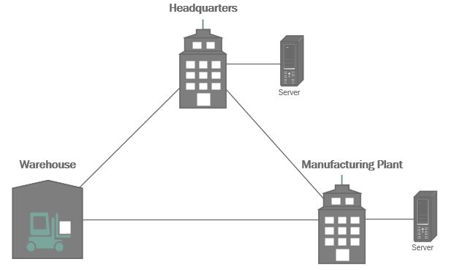
On-Premise Virtualization
RAID 1 for operating-system, RAID 5 for Guest VMs.
VMware ESXi as Bare Metal Hypervisor.
Advanced management console with vCenter.
Integrated patching of server and server management infrastructure.
Notes:
(40 seconds)
We decided to have two physical servers one in HQ and the other in MP sites which are the two busiest sites of this enterprise.
After configuring disk redundancy, we installed ESXi as the hypervisor OS. And once we installed the ESXi, we deployed vCenter SA so we can manage the virtual environment more practically. And now that our virtual infrastructure was ready, we could now migrate DC and FileServer using the same methods we used in our tests.

Slide 6
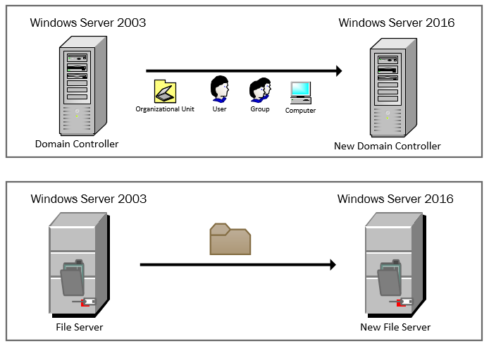
Domain Migration
Live Migration
Notes:
(60 seconds)
As soon as we were provided with our VMs, we tested our migration strategy on Vmware workstation.
The migration method we used for Active Directory was the Live migration method. This migration strategy will help us perform our Active directory migration with zero down time by separating the upgrading the server OS and migration process.
We also tested File server migration. The important point here was transferring the NTFS permissions while transferring the files. And we used Microsoft Migration Tool to make sure that NTFS permission are also migrated.
After verifying the accuracy of these tests, we were nearly good to go and perform this migration in our virtualized platform on the physical servers, but before that we had to prepare this physical and virtual environment.

Slide 7
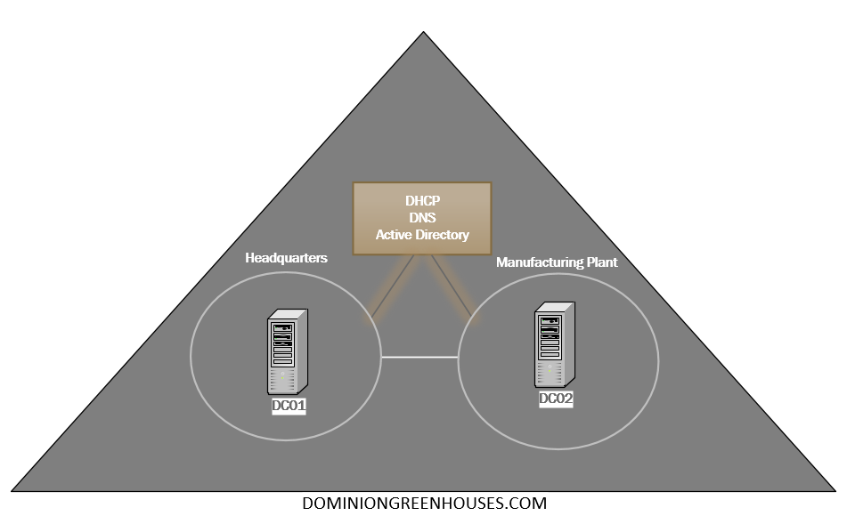
Domain Controllers
Notes:
(30 seconds)
-Since we have two server in different sites we thought that we could have another DC in the MP so that we can provide load-balancing and failover for the Active Directory, DNS and DHCP server services running inside our DCs.
-To provide load balancing and failover for the services running on our Domain Controllers we have separate controllers in both Manufacturing and Headquarters.
-

Slide 8
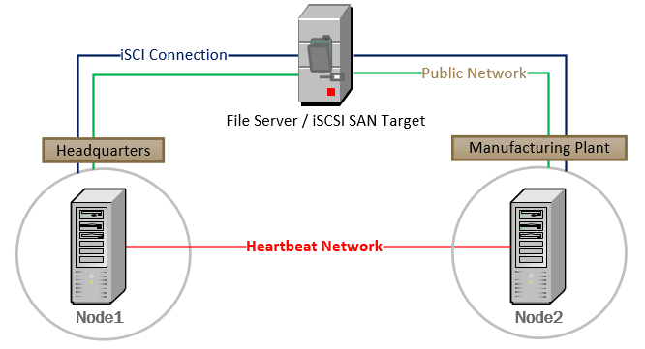
Failover Clustering with SAN
Notes:
(40 seconds)
It’s the same deal with File Server. Just like DCs it is also important to provide high availability and redundancy for our resources. This image here displays two cluster nodes in different sites connecting to an iSCSI target storage which stores our network resources. The failover nodes are configured to take up if the other goes down. But it’s still possible that both nodes can go down, or even our file server can go down not come up again. For this reason we also need a backup solution to back up our critical data.

Slide 9
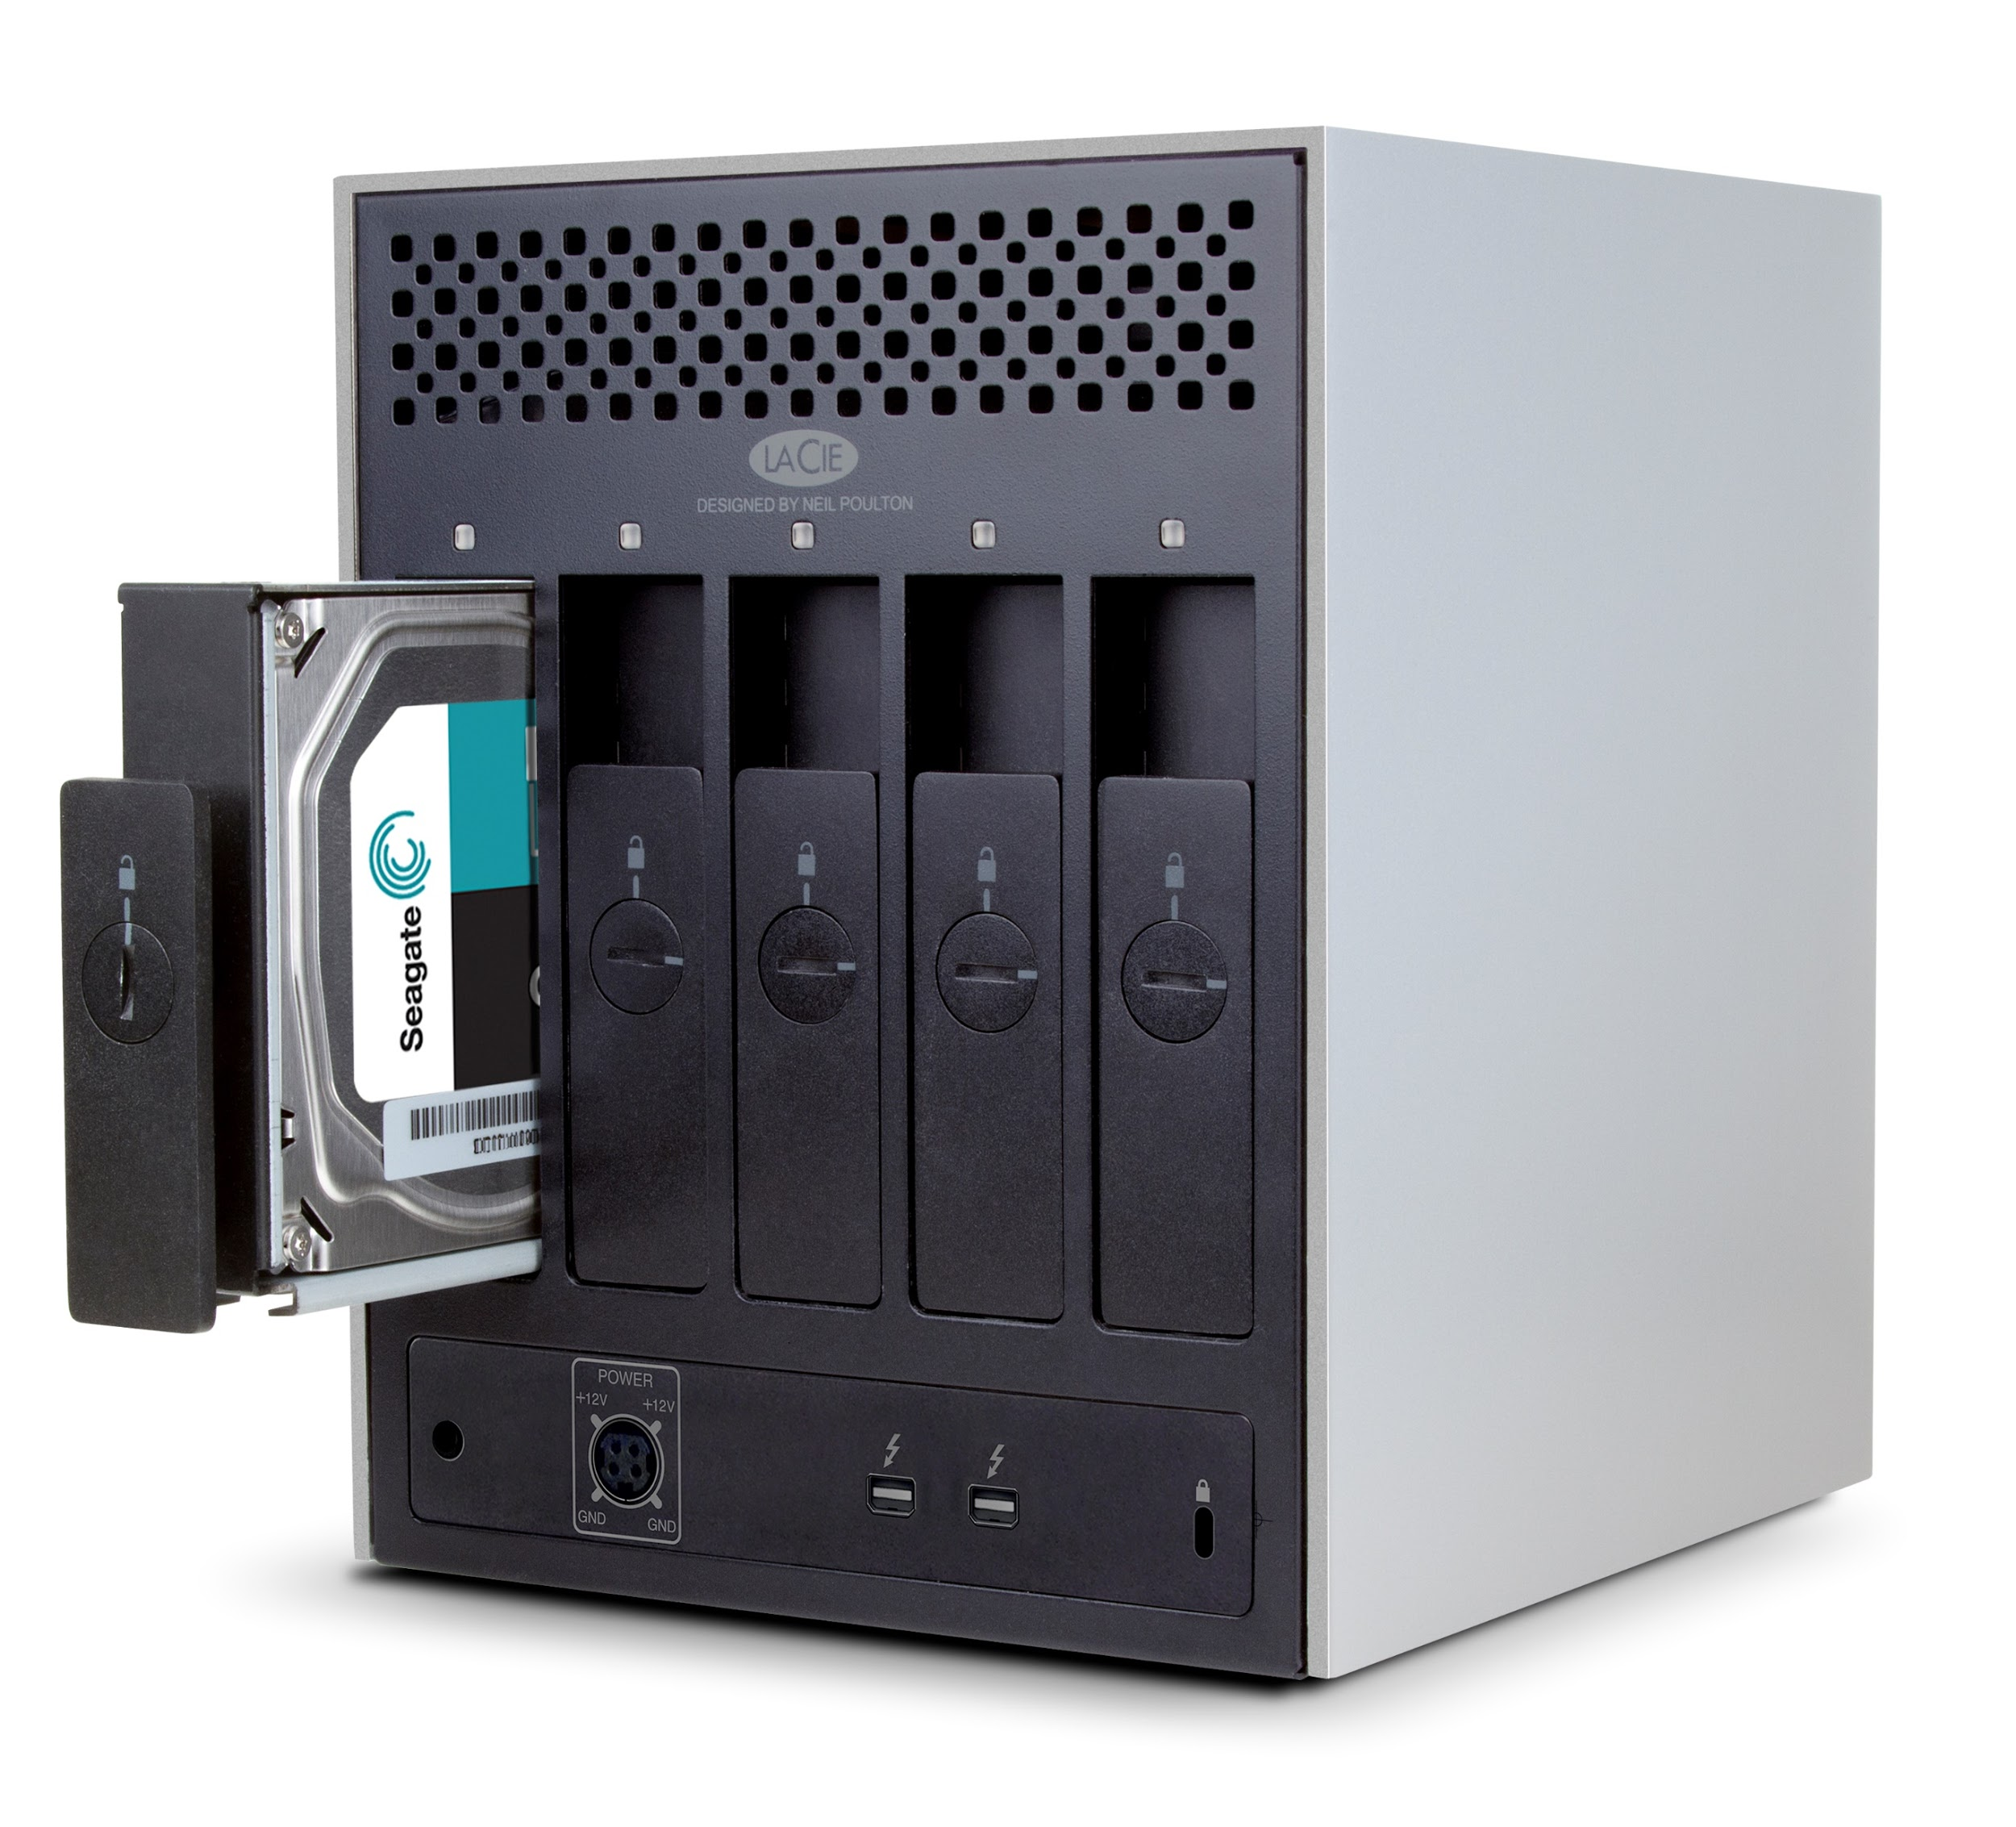
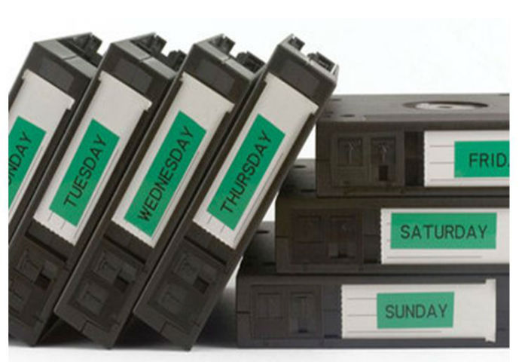
Backup Policy
3-2-1 Rule
3- At least three copies of data: original data and two backups.
2- At least two different media storage types; on-site local disk and off-site hard drive backup
1- At least one off-site backup; off-site hard drive backup.
Notes:
(20 seconds)
Our backup policy is based on a common rule known as 3-2-1. And by sticking with these rules, we will have 3 copies of data, 2 two different media storage types, and at least 1 off-site backup.
What do we back up :
Application-aware backup of the DC with FSMO roles.
File Server
Persistent VDIs

Slide 10
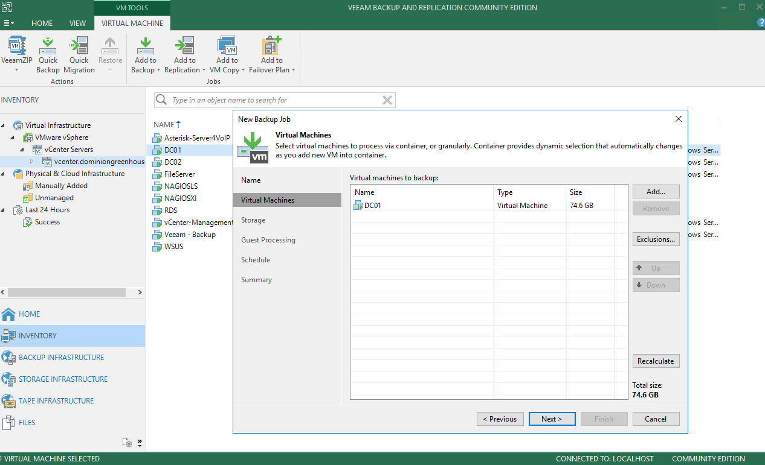
Veeam Backup & Replication Server
Notes:
(45 seconds)
Our on-site backup solution is Veaam Backup Server. It’s a VMware product and very easy to deploy. Another appealing feature of it in our case was that it can be integrated with vCenter; as soon as it’s connected to vCenter detects all the virtual machine inventory in the vCenter. It allows us to perform different backup methods such as application-aware and file-level backups. These different backup and restore features can be very helpful when recovering from a disaster.
Application aware-image based backup
-Simple, integrates with VMWare, (IT staff?)
-What we’re backing up, all our servers can be backed up because they’re on esx

Slide 11
Server Recovery
Domain Controller 1. Replicate from a running domain controller. 2. Restore application-aware backup with Veeam. 3. Recover from off-site backup.
File Server 1. File-level recovery with Veeam. 2. Restore virtual machine with Veeam. 3. Recover from off-site backup.
VDI 1. Restore virtual desktop with Veeam. 2. Create a new virtual desktop.
Notes:
(60 seconds)
For example, our domain controller has died, or the whole physical server is down and we have no option but restore these servers. Our first step for domain controller would of course be promoting a new server as DC and replicate from the DC in the other site, if it is still running. If not, we would restore our application-aware backup which is another feature that Veeam supports.
For the File Server, if the virtual machine is still running but the files have been damaged, we can use file-level recovery with Veeam backup server and minimize downtime in comparison to recovering the whole VM.

Slide 12
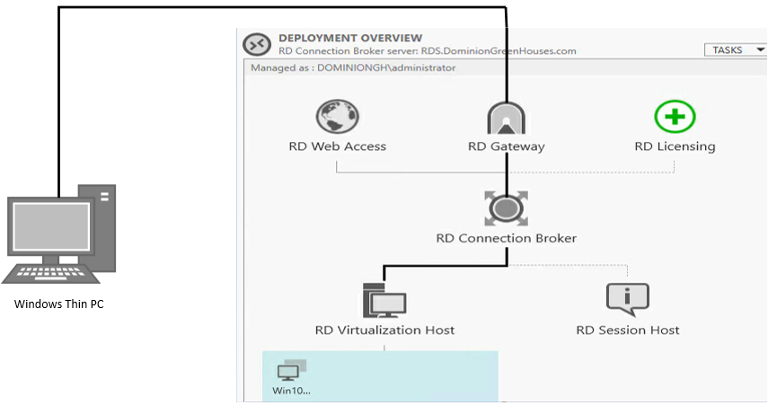
Thin Client Solution
Server-side : Remote Desktop Services Client-side : Windows Thin PC
Notes:
(100 seconds)
The thin client solution breaks down into two components as server-side and client-side. We are running an RDS server and Hyper –V on the same server to implement the virtual desktop infrastructure. And these VDIs are persistent because we want to allow our users to have a more specialized desktop environment. On the client-side, our product is Windows Thin PC, which requires only 5 GB disk space to be installed. We are making use of some scripts and HKEY entries to make our thin client machine RDP immediately to virtual desktop when the user logs on.
When we were implementing this solution, running RDS and Hyper-V on the same server made things a little complicated. Because the virtual desktops were deployed as nested VMs, we were having problems with virtual networking; we were not getting internet connection on nested VDIs. It took a while to figure us out that it was not a problem with Hyper-V, it was the ESXi that had to be configured to allow nested virtual network traffic.

Slide 13
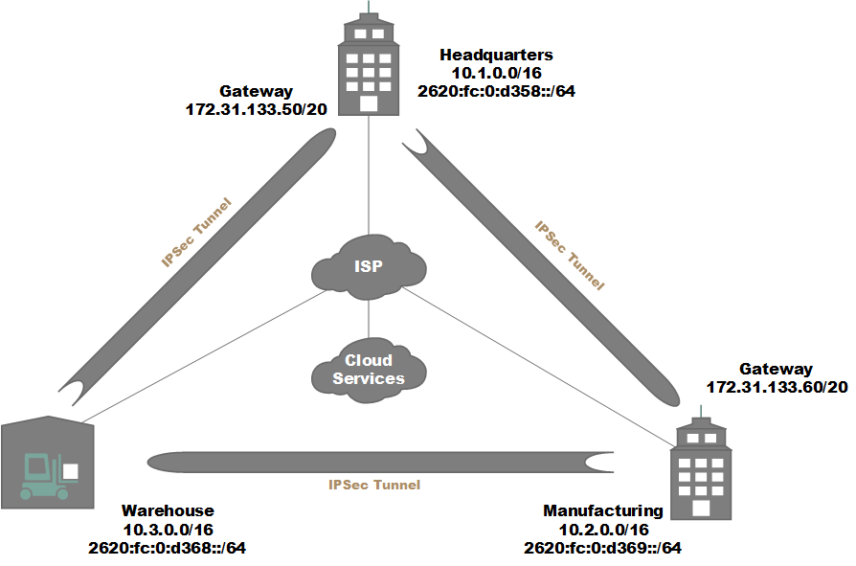
Notes:
(35 seconds)
We were left with a lot of leeway for our network implementation, so we started with the services required by Dominion Greenhouses and built the network to support that. Each of Headquarters, Manufacturing and the Warehouse have a site-to-site tunnel to each other branch over both IPv4 and v6 to allow clients to securely reach the servers at other branches, as well as for access points to use the wireless controller at HQ. We used Google for cloud services, so client traffic is secured with TLS and data in transit uses IPSec tunnels as well.

Slide 14
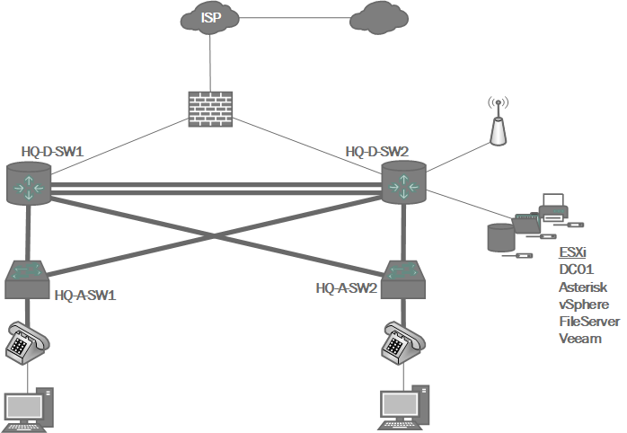
Headquarters
Notes:
(1 minute)
Each branch has a hierarchical design with a layer 2 access layer, a layer 3 distribution layer and an ASA as a gateway to the outside.
VLANs and ACLs on the distribution layer switches were used to segregate communications within the branch, like Voice, Data, Guest and Secured Wireless, Servers, and Management traffic, whereas traffic incoming to the network is filtered at the firewall, and is restricted to inter-branch communications and remote management VPN connections.
For example, clients on the secured wireless network will get access to the services provided at HQ and MP, but clients on the Guest wireless network will be sent straight out to the internet without access to anything internal.
Distribution switch 2 has all GigE ports so we used it as the default gateway for IPv4 and IPv6, failing over to Switch 1 in the case of device or uplink failure. DS2 is also the wireless controller for all access points at each branch.

Slide 15
Manufacturing
Notes:
(15 seconds)
The Manufacturing Plant is nearly identical. Like at HQ, access through the firewall is restricted to inter-branch communications and the distribution routers failover to each other, except here the hardware is similar so we load-balanced ipv4 and ipv6.

Slide 16
Warehouse
Notes:
(15 seconds)
The Warehouse is almost entirely wireless, and no servers are hosted here, so the clients at the warehouse use the services provided at HQ, Manufacturing and the Cloud.

Slide 17
NTP
Notes:
(40 seconds)
We tuned each of the dynamic protocols, including spanning-tree, network time protocol, VLAN-trunking, OSPF, and HSRP, to all stabilize in a predictable way. As an example, this shows the NTP hierarchy where we have chosen some lesser-utilized routers to fetch NTP updates. This serves to regularly test their connections out and the connections of devices to them, and because the network is predictable it is much more manageable. Network devices are configured to send traps to alert the network admins of important changes on the network, such as link failure or high CPU utilization. On that note I will turn to Jacob to discuss our logging and monitoring solutions.

Slide 18
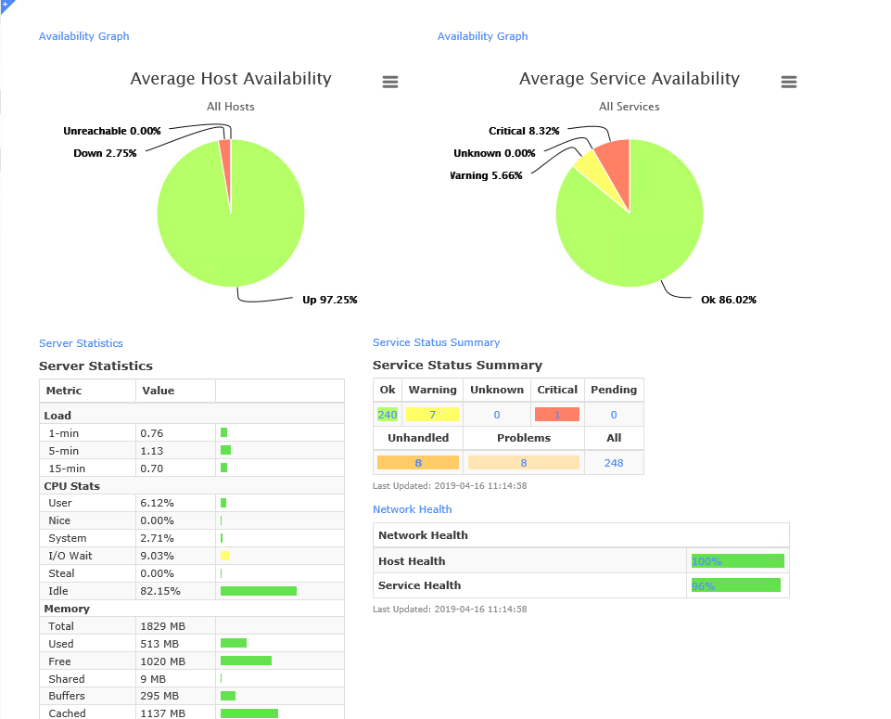
Nitrix IX
Monitors Windows, Linux, Cisco ISO
SNMP Traps
Proactive
Notes:
Thankyou Darren
On the topic of server monitoring we used Nagios XI is our server monitor.
Nagios XI enables allows us to monitor both windows and Linux servers.
We can also monitor our Cisco switches and routers with SNMP.
Nagios XI allows for the use of SNMP traps, this allows up to specifically monitor aspects of our network.
With A real time look of our network an I.T team can react proactively rather than reactively too potential server and network problem.

Slide 19
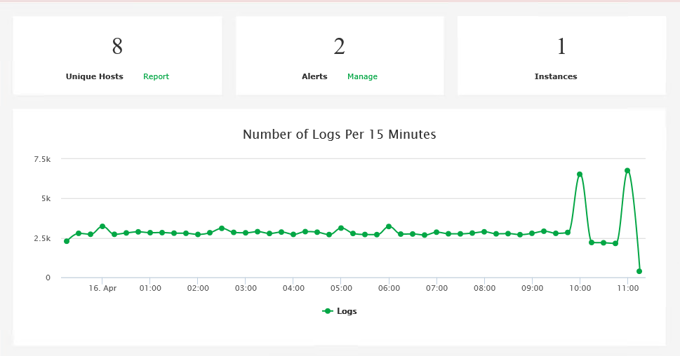
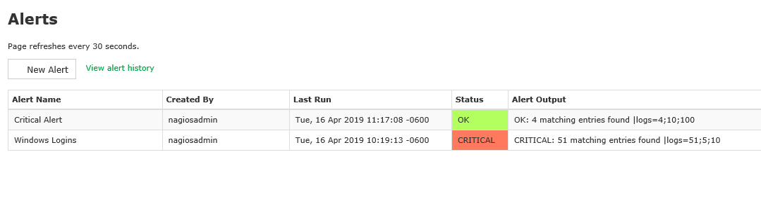
Nitrix LS
Accumulates Logs
Create Filters
Send Alerts
Notes:
For our log server we chose Nagios LS. This server allows us to amalgamate logs from all our other servers.
We can then use filters these logs.
From the filters we can create alerts through Nagios LS.

Slide 20
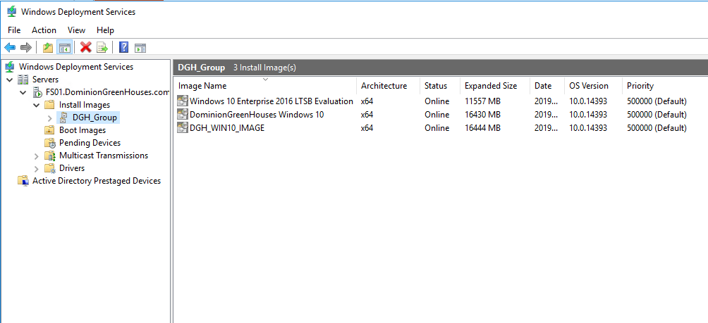
Windows Deployment System
Windows 7 Upgrade
Increase Productivity
No USB
Notes:
To facilitate our domain upgrade to Windows 10, we are going to be utilizing Windows deployment system. Windows deployment system will allow us to image the old Windows 7 computers, and any new devices through the network. This will drastically save time, Since an administrator will not need to move workstations or wait for USB sticks.

Slide 21

Cloud SaaS - G Suite
Notes:
For our productivity suite we are utilizing the software-as-a-service platform G Suite. G Suite will provide DominionGreenHouses with a word processor, file system, and email.

Slide 22
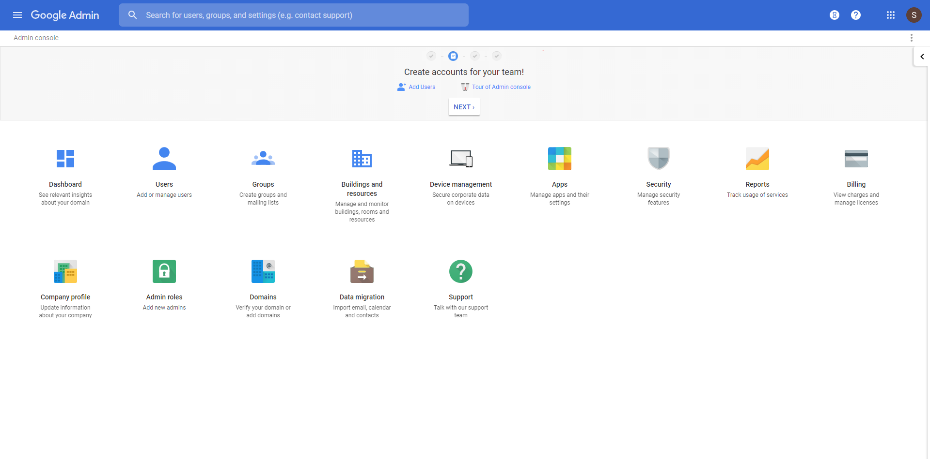
Why use G Suite?
Used by fortune 500 Corporations
Fully Backed up
SLA 99.95%
Two Factor Authentication
Secure
Notes:
Why use G-Suite?
G Suite is used by fortune 500 corporations such as whirlpool and Broadcom.
Google Docs, slides, and sheets are backwards compatible with their Microsoft equivalent products.
Google Drive, and Gmail are fully backed up and extensive logging is available to administrators.
G Suite comes with a service-level agreement of 99.95%. G Suite is secure, We enforce the use of two factor authentication, which will improve security.
G Suite also complies with numerous ISO standards: (ISO27001, ISO27017, ISO27018). As well as other certifications allowing G Suite to be used in the fields of health and government.

Slide 23
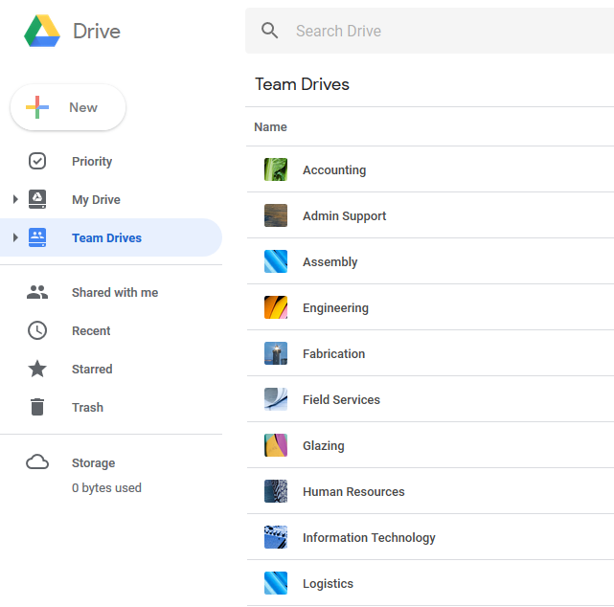
G Suite - Google Drive
File System
Least Privilege
Backwards compatible with MS Word, Powerpoint, Excel
Notes:
Going more in depth into google drive. Google Drive allows the creation of team drives.
I compare a team drive to a network drive in an NTFS file system, The advantage being that google drive is available over the internet.
Like in active directory you can add users too these team drives through the use of security groups.
This allows us to achieve the security principle of least privilege on our customers files.
With two factor authentication enabled for all users, we feel confident that we can use G suite for sensitive data.
To reiterate Google Docs, slides, and sheets are backwards compatible with their Microsoft equivalent products.

Slide 24
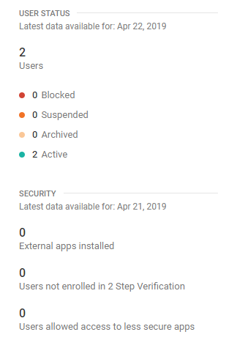
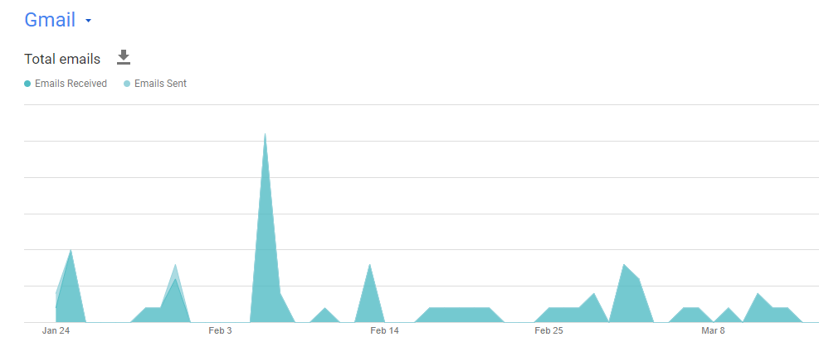
Google Reports
Extensive logging
Tones of features
Enables Security Enforcement
Notes:
As I mentioned before google provides extensive logging for administrators. This is done through google reports. Here you can track a ton of data, from the number of users not enrolled with two factor authentication. To the number of emails sent, to the number of files shared. To what user was logged into with what IP address at what time.

Slide 25
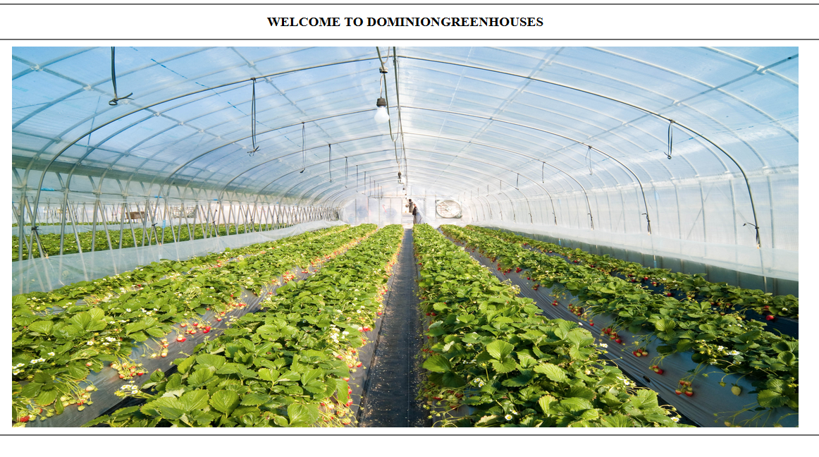
Cloud IaaS - Google Cloud Platform
Reduce Capital costs
$23 / Month
Montreal Data Center
Notes:
For our customers website, we are using google cloud platform as our Infrastructure-as-a-service host. By using Google cloud platform we are able to eliminate short term capital hardware expenses to the cloud. With a three year commitment our web solution will only cost DominionGreenHouses $23 per month or $830 over the three year period. That price is in Canadian dollars. Our instance is hosted in the googles Montreal data center.
Now I give the torch too Darren, to talk about security.

Slide 26
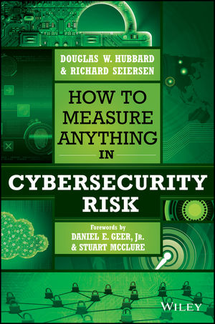

Notes:
(45 seconds)
Regarding security and loss prevention, the purpose of Dominion Greenhouses’ network is a service that increases the efficiency of its employees and does not bring any direct income on its own.
Because we have our sensitive data on the cloud secured with 2FA, and because we have reliable back-ups, the main cost of a security breach in this case is reduced efficiency of operations and the lost time for the IT team to recover.
With that in mind we approached analyzing the ROI of solutions based on the frameworks outlined in these books.
They propose using the existing network as a baseline and then using large ranges to approximate the costs of compromise and using probabilities and simulations on the set to measure the effectiveness of a solution.

Slide 27
Network Baseline
Reliable backups
Host-based antivirus
2-factor authentication
Authenticated protocols
Controlled protocols
Redundant failover devices
Access-layer security
Logging
Controlled management access
Explicit firewall/ACL rules
IPSec inter-site VPNs
Least privilege
Notes:
(30 seconds)
The baseline represents the current state of the network, so the network and services that we’ve discussed so far minus the cloud represents our baseline network.
From the baseline we categorized proposals based on if they help us prevent, detect or respond to incidents and adjust our simulation values.
For example, an IDS will reduce the upper bounds cost of certain breaches, whereas an WSA would reduce the likelihood of a breach. Then we can run the simulations with those new numbers and compare to our baseline to evaluate the ROI.

Slide 28
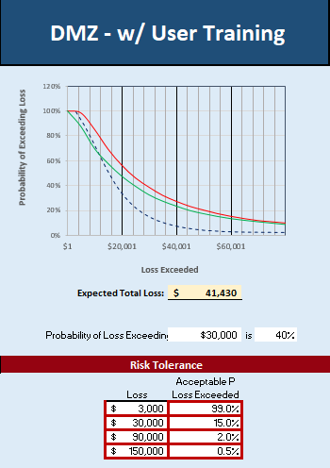
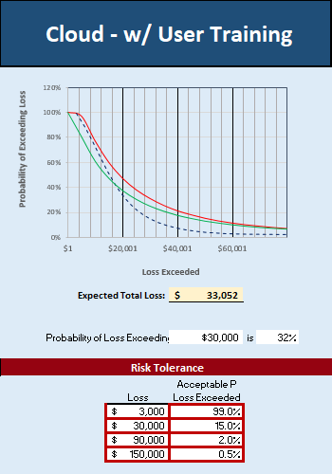
RISK TOLERANCE
INHERENT RISK
RESIDUAL RISK
Notes:
(1.45 minutes)
The main result of running these simulations are these expected loss graphs, the values we used to get these graphs can be found on our Github page.
The red lines are the inherent risk, which is the risk of the baseline network, the black is the risk tolerance of the organization, how much risk an organization is willing to accept, in this case we had to make an estimate about what would be acceptable for them and the green shows the risk as a result of our mitigation, in this case quarterly end-user training.
The simulations that use the cloud on the right already align much more closely with what we propose to be a reasonable risk tolerance in this case. Assuming our cloud services come bundled with a suite like GSuite or Office 365 that we need anyway, the ROI is about $8000.
----------------------------
The reduction for the Cloud vs DMZ is the result of lowering the probabilities of certain privileged compromises by 10-15% that would use the DMZ to gain an initial foothold, and we made this assumption because, although the DMZ and Cloud services may both be open to automated scanning and attack tools, the Cloud provider would likely filter that, and our firewall may or may not. The other reason is the added complexity of managing the firewall and DMZ services which add some risk as well. So if the chance of a particular compromise was 20% then we’re proposing that can be reduced from once every 5 years to once every 10 years by using the cloud instead of a DMZ.

Slide 29
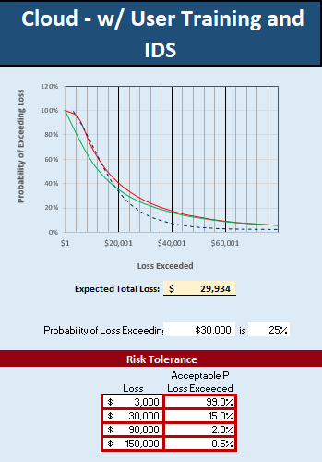
RISK TOLERANCE
INHERENT RISK
RESIDUAL RISK
Notes:
Lastly, the graph on the left shows again the Cloud w/ User training where the graph on the right shows that with the addition of a dedicated IDS.
They look very similar but the addition of an IDS has a significant decrease in the cost of expensive breaches.
The probability of loss exceeding $30000 has dropped 7%, which is nearly as much as our DMZ to Cloud simulation, at 8%, and the expected total loss has dropped $4000, so although the IDS may not pay for itself annually over time it will give a positive return on investment.
The easiest gains were made by moving services to the cloud that would require a DMZ, like email and the website.
But in total, by spending about $10000 a year on user training and $10-15000 on maintaining an IDS, and using the cloud for externally-accessed services the expected loss drops by about $12-15000 annually, which is still not a complete return on investment, but we think that the slight loss is justifiable because the effects of training will be cumulative, and an IDS can significantly reduce the cost of expensive less-frequent breaches.

Slide 30
Thank You
Stephanie Remniak
Brian Nelson
Guy Mitchell
Terry Pearce
Chris Redford
Lester Fundora
AJ Armstrong
Claudia Calin
Troy Gregoire
Notes:
Lastly, the graph on the left shows again the Cloud w/ User training where the graph on the right shows that with the addition of a dedicated IDS.
They look very similar but the addition of an IDS has a significant decrease in the cost of expensive breaches.
The probability of loss exceeding $30000 has dropped 7%, which is nearly as much as our DMZ to Cloud simulation, at 8%, and the expected total loss has dropped $4000, so although the IDS may not pay for itself annually over time it will give a positive return on investment.
The easiest gains were made by moving services to the cloud that would require a DMZ, like email and the website.
But in total, by spending about $10000 a year on user training and $10-15000 on maintaining an IDS, and using the cloud for externally-accessed services the expected loss drops by about $12-15000 annually, which is still not a complete return on investment, but we think that the slight loss is justifiable because the effects of training will be cumulative, and an IDS can significantly reduce the cost of expensive less-frequent breaches.

Slide 31
DOMINION GREENHOUSES
Presented by Team Trogdor
https://github.com/netengtechsolutions/bulknetwork
Notes:
Our Active Directory and bulk network configuration and monitoring scripts are all hosted on our Github page, as well as our submitted documentation, this powerpoint and the excel spreadsheets that we used in our risk analysis.

